Slide 1
Indoor 3D Reconstruction from Laser Scanner Data
Shayan Nikoohemat
March 2018
Promoter: Prof. Dr. Ir. George Vosselman
Supervisor: Michael Peter

Slide 2
Indoor 3D Model Reconstruction to Support Disaster Management in Large Buildings
Smart Indoor Models in 3D (SIMs3D)
Academic partners:
WP1: University of Twente (UT), EOS Department
WP2: Delft University of Technology (TUD), GIS Technology

Slide 3
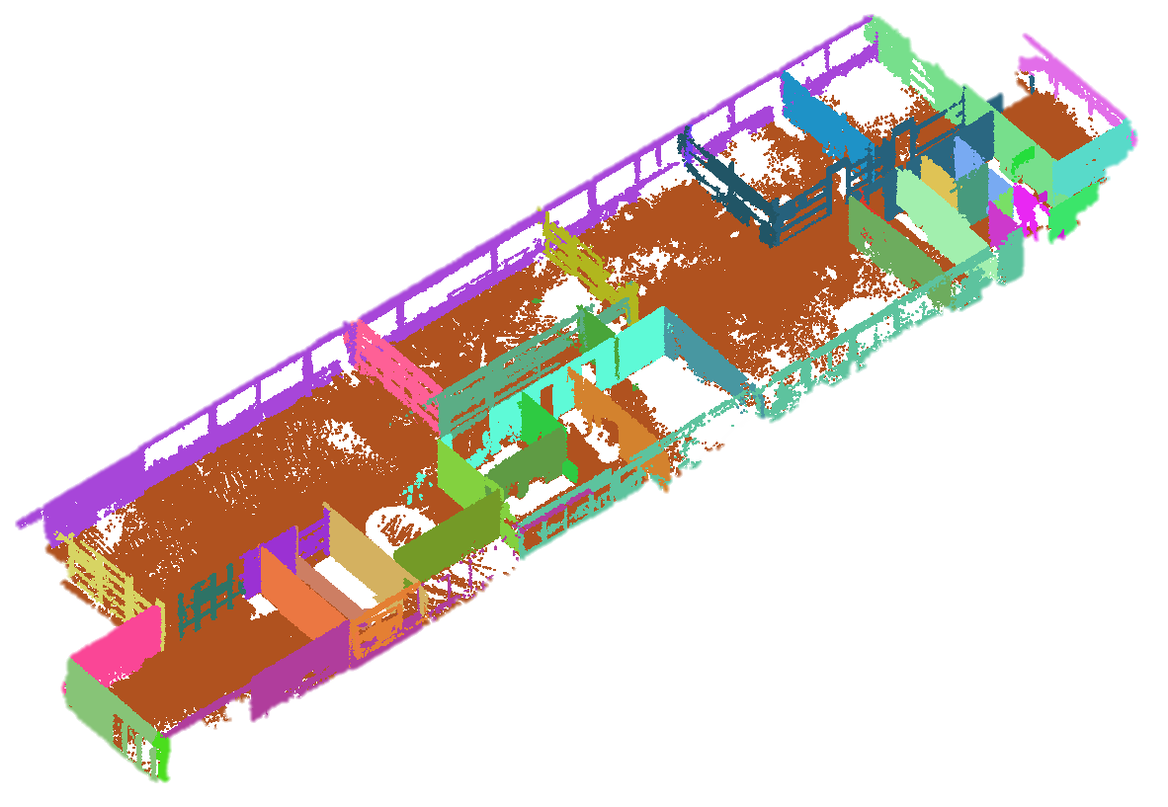
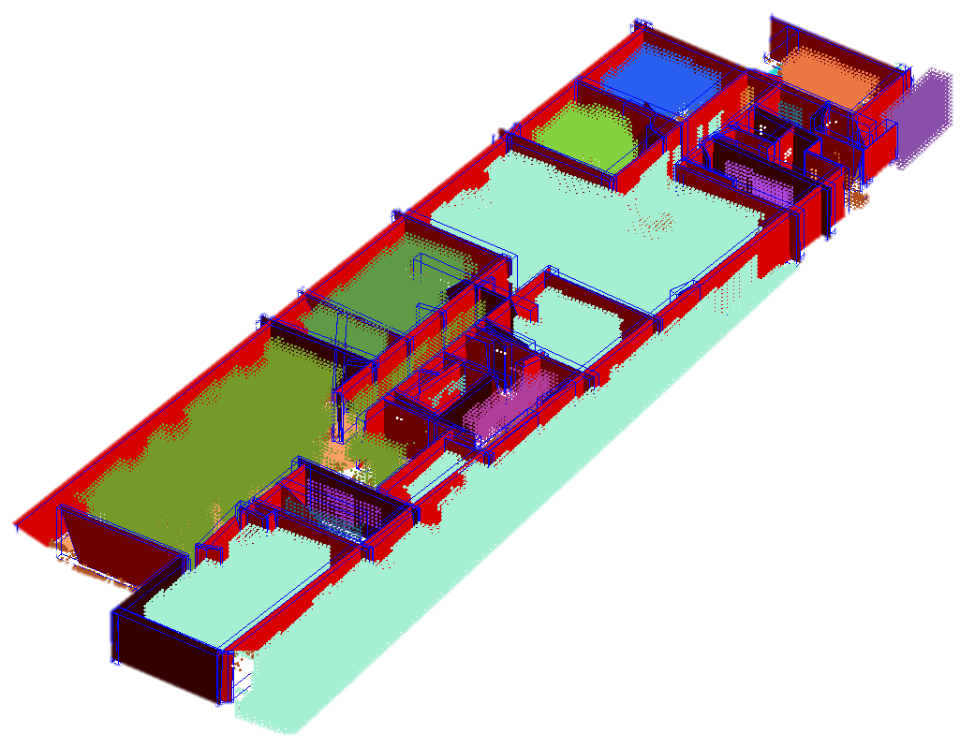
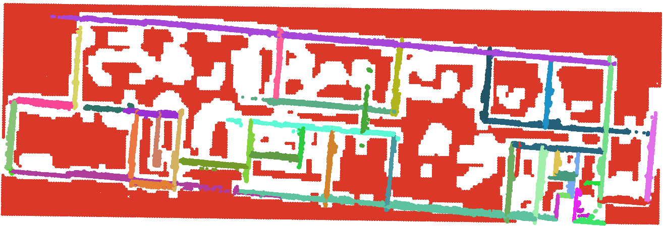
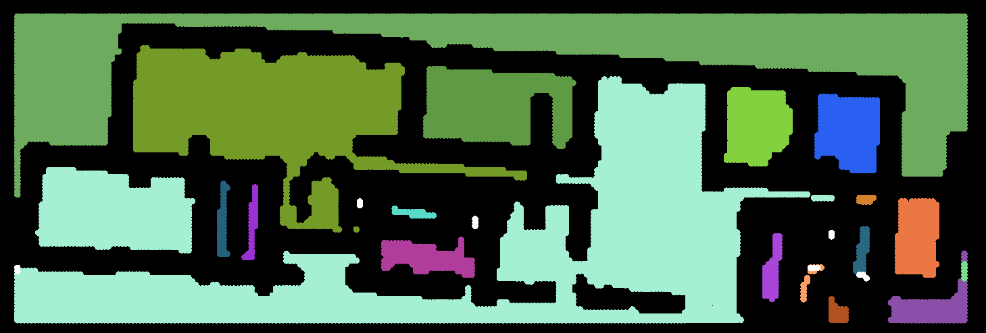
Indoor 3D Model Reconstruction to Support Disaster Management in Large Buildings
Smart Indoor Models in 3D (SIMs3D)
WP1. Geometry Extraction
Permanent structure (walls, floor, ceiling)
Openings (doors, windows)
Navigable/Walkable Space
Space Partitions
Walls, floor
Space partitions
Walkable Space
Space partitions, walls and doors

Slide 4
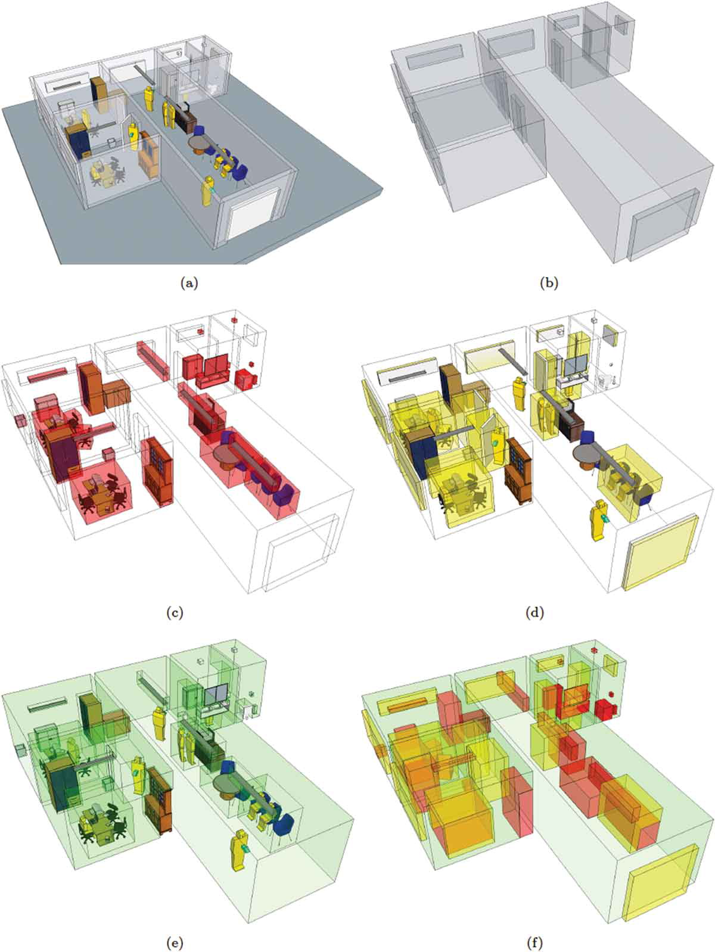
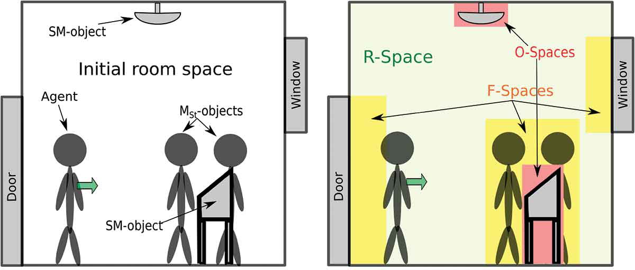
Indoor 3D Model Reconstruction to Support Disaster Management in Large Buildings
Smart Indoor Models in 3D (SIMs3D)
WP2. 3D Models and Algorithms
User Centered Space Subdivision
Functional Space
The Flexible Space Subdivision (FSS) Framework
Object-Space, Functional-Space
and Remaining-Space (navigable space)
FSS of a BIM model

Slide 5
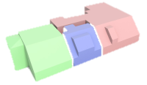
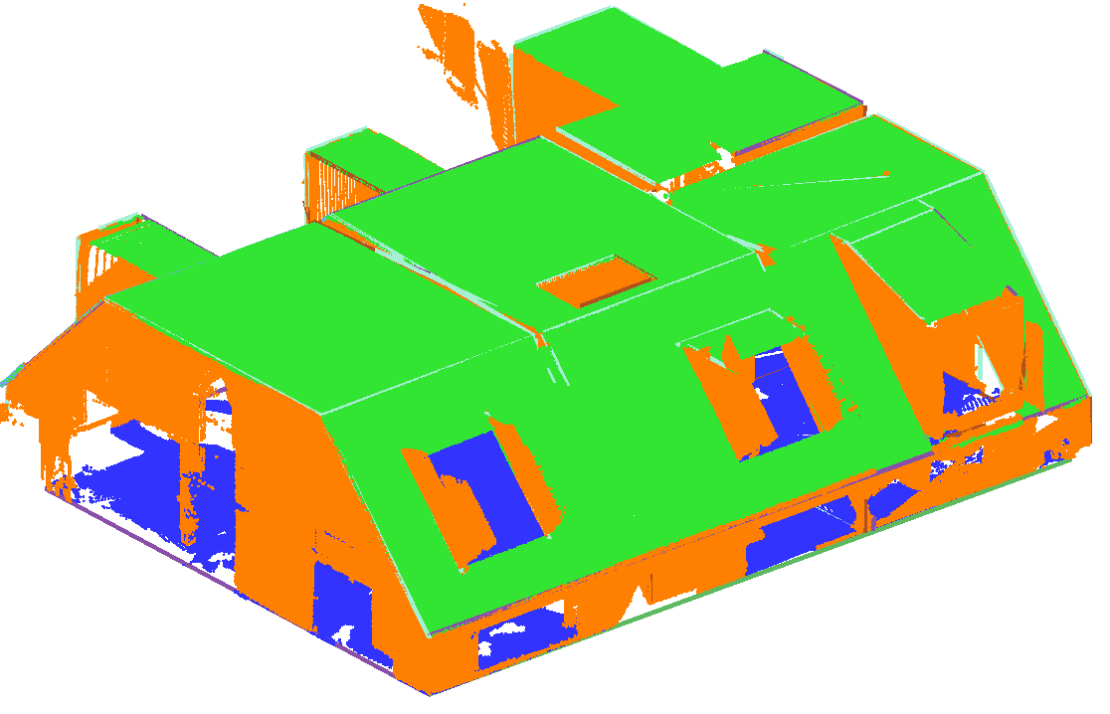
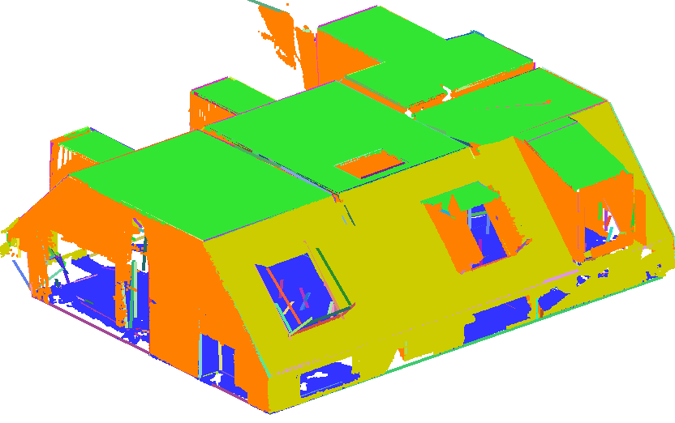
Indoor 3D Model Reconstruction to Support Disaster Management in Large Buildings
Structure Detection in non-Manhattan World Buildings
Mura et al. (2016)
ceiling
ceiling
floor
floor
Angle threshold
(V< 40° < H < 90 °)
wall
Angle threshold
(V< 50 ° < H < 90 °)
wall
Slanted-wall

Slide 6
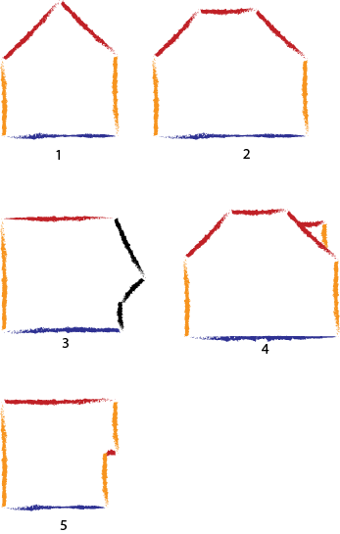
Indoor 3D Model Reconstruction to Support Disaster Management in Large Buildings
Smart Indoor Models in 3D (SIMs3D)
Structure Detection in non-Manhattan World Buildings
Case 1, 2, 3 and 4 could be handled.
Case 5 could be problematic. Because the lower ceiling
could be removed during the process.

Slide 7
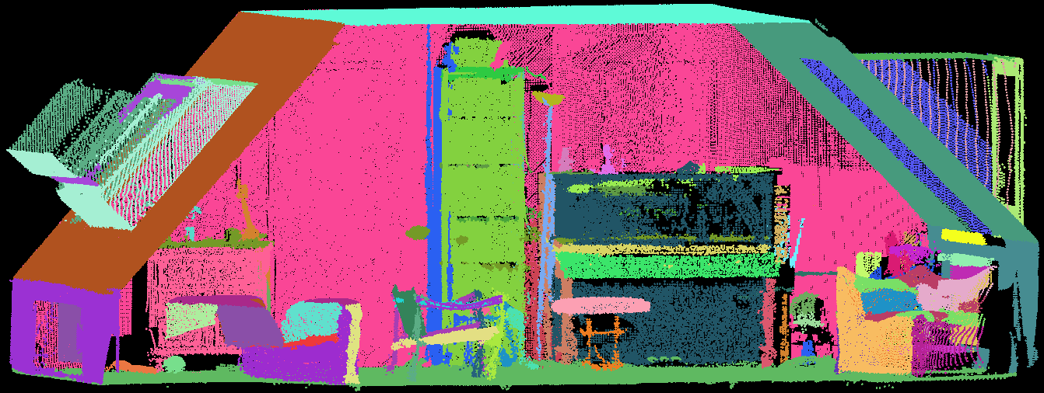
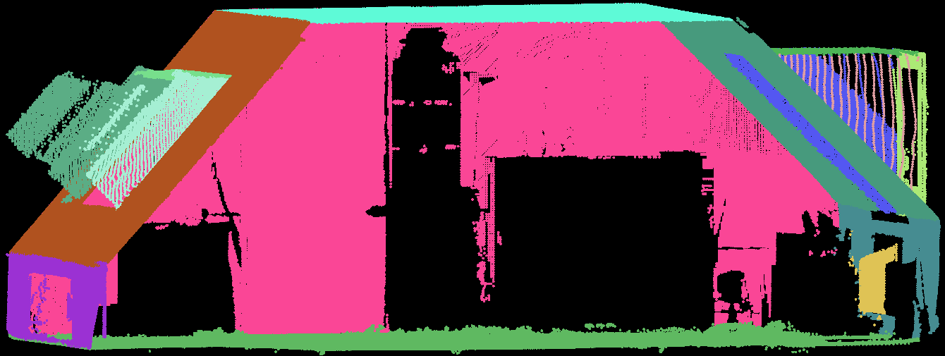
Indoor 3D Model Reconstruction to Support Disaster Management in Large Buildings
Improving the algorithm
Cluttered point clouds
Walls, floor and ceiling

Slide 8
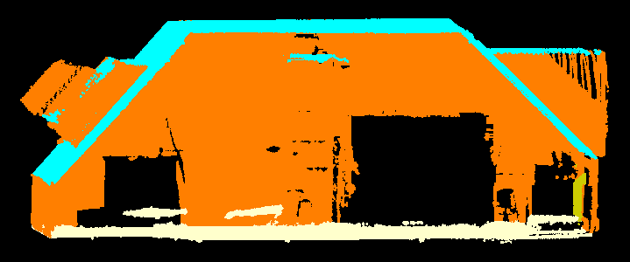
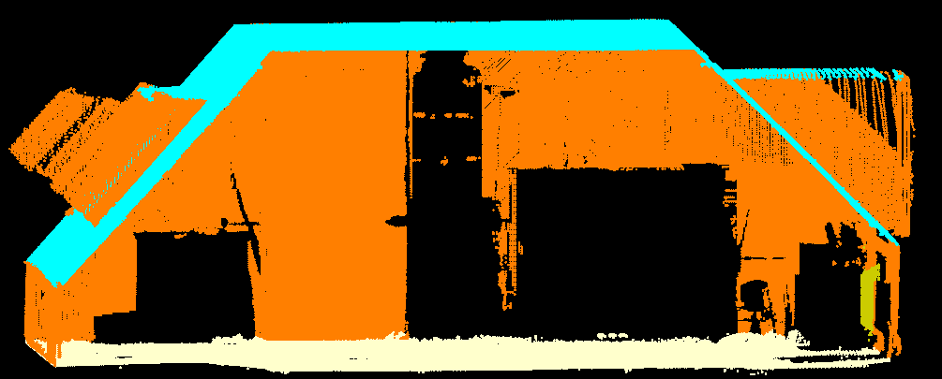
Indoor 3D Model Reconstruction to Support Disaster Management in Large Buildings
Improving the algorithm
Walls, floor and ceiling

Slide 9
Indoor 3D Model Reconstruction to Support Disaster Management in Large Buildings
Smart Indoor Models in 3D (SIMs3D)
Integration of WP1 and WP2
Motivation: using the real data to subdivide the space based on the permanent structures and dynamic objects (furniture) and agents
Challenge1: the extracted geometry from the real data is never 100% correct.
Challenge2: all the doors are not detected.
Challenge3: there are false positives and false negatives in the data.
Suggestion: We need interactive corrections by the operators

Slide 10
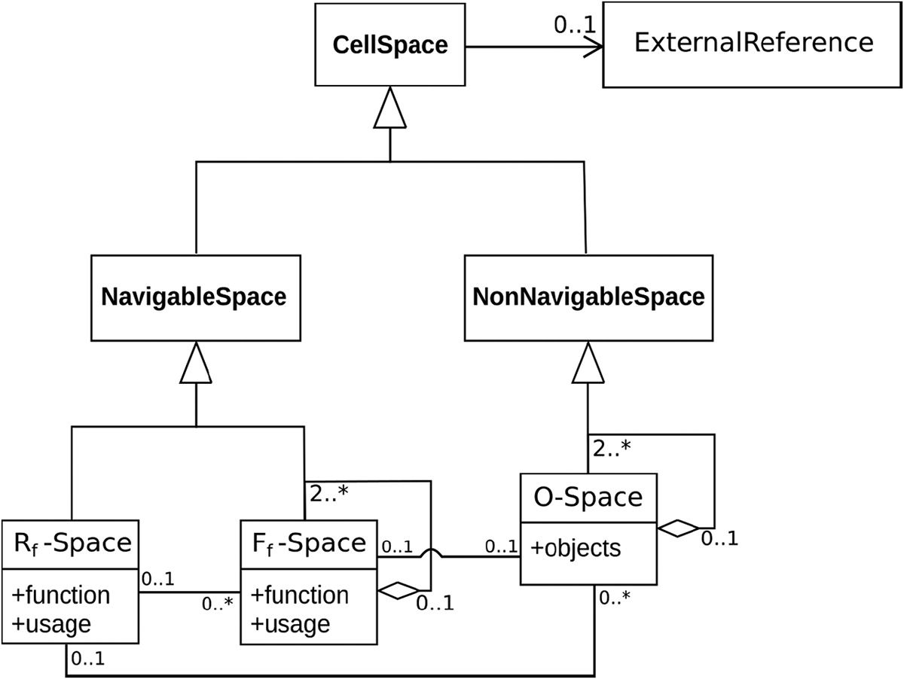
Indoor 3D Model Reconstruction to Support Disaster Management in Large Buildings
Smart Indoor Models in 3D (SIMs3D)
Integration of WP1 and WP2
WP2
(Space Subdivision)
WP1
(Geometry Extraction)
Free space
Navigable space
Doors, openings
Clutter, obstacles
Walls, floor, ceiling
indoor
point clouds

Slide 11
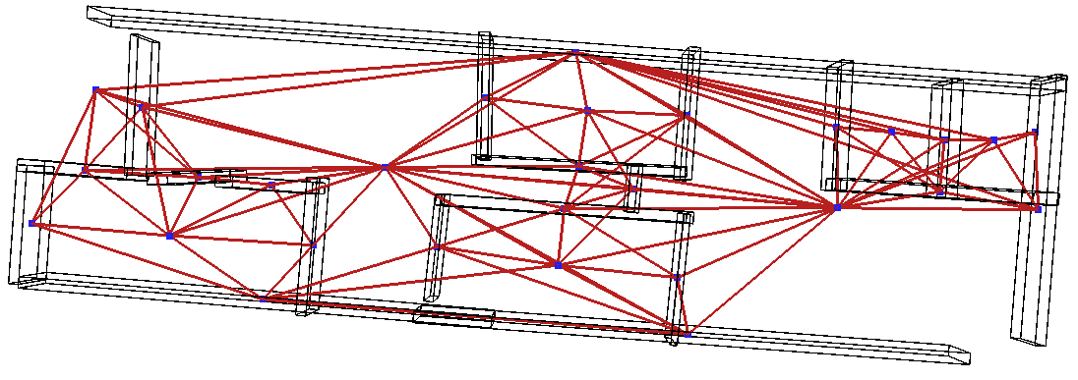
Free spaces connected by a graph to each other
The graph looks for the neighbor spaces within a threshold
The same graph of left image, spaces layer is off
Free spaces and walls
A graph that connects walls and spaces, to check if two spaces
are connected via a wall or not.
However, just using the proximity and center of the objects
to perform such a check is not correct.

Slide 12
Indoor 3D Model Reconstruction to Support Disaster Management in Large Buildings
Smart Indoor Models in 3D (SIMs3D)
Interactive corrections:
Change the incorrect labels (4%)
Extension of the disjoint walls (3-4%)
10 mins of manual work
Label change
Wall extension

Slide 13
Indoor 3D Model Reconstruction to Support Disaster Management in Large Buildings
Smart Indoor Models in 3D (SIMs3D)
Generate the R-Space and O-Space
Select some of the furniture manually and add to the model
Generate the spaces with walls+ floor+ ceiling
Generate the (R-Space) remaining-space
Generate the O-Space with the obstacles and R-Space

Slide 14
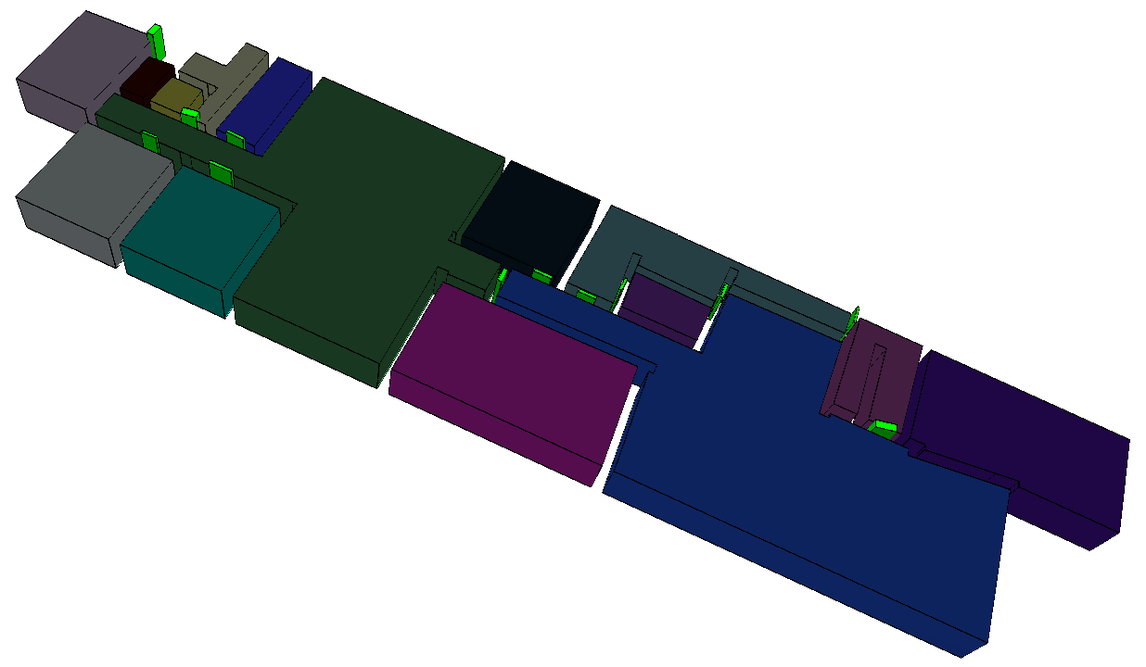
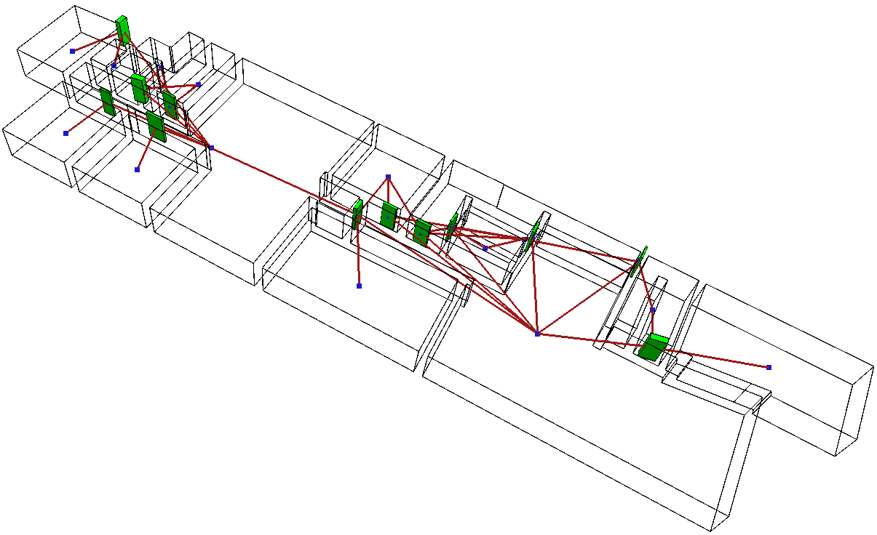
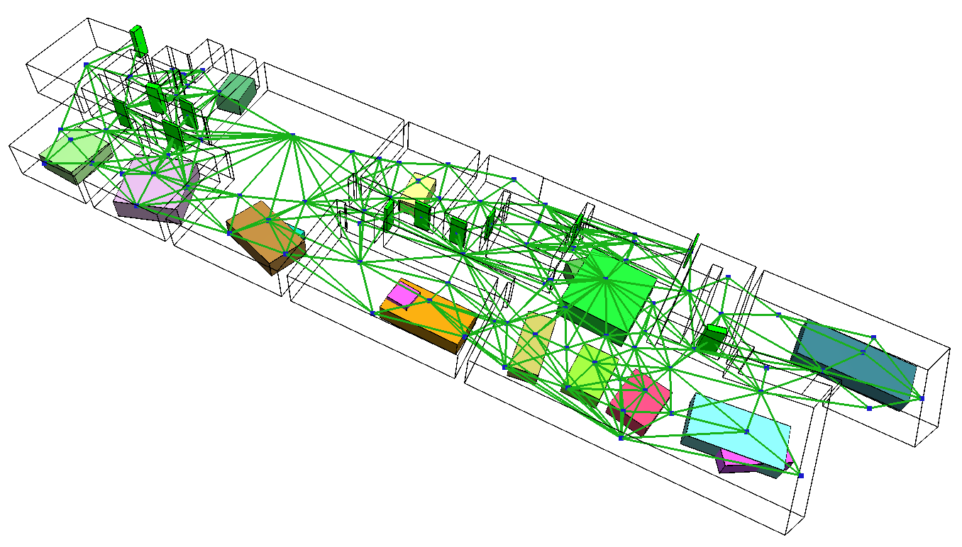
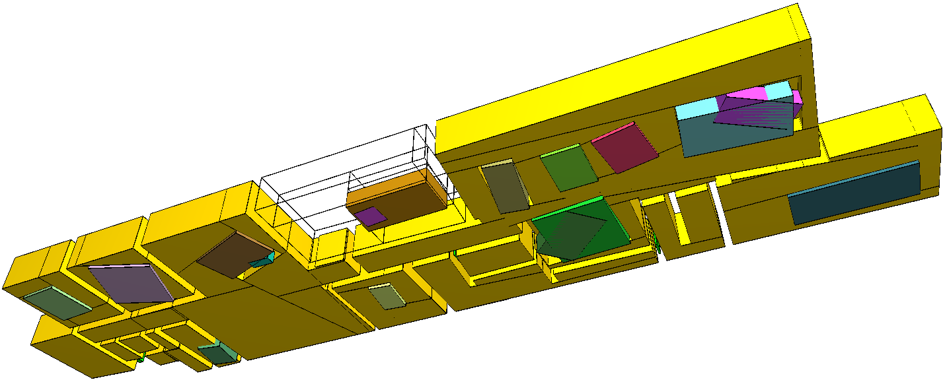
Indoor 3D Model Reconstruction to Support Disaster Management in Large Buildings
Smart Indoor Models in 3D (SIMs3D)
Modified Model
Spaces
Graph of Spaces and Doors
O-Spaces and R-Spaces

Slide 15
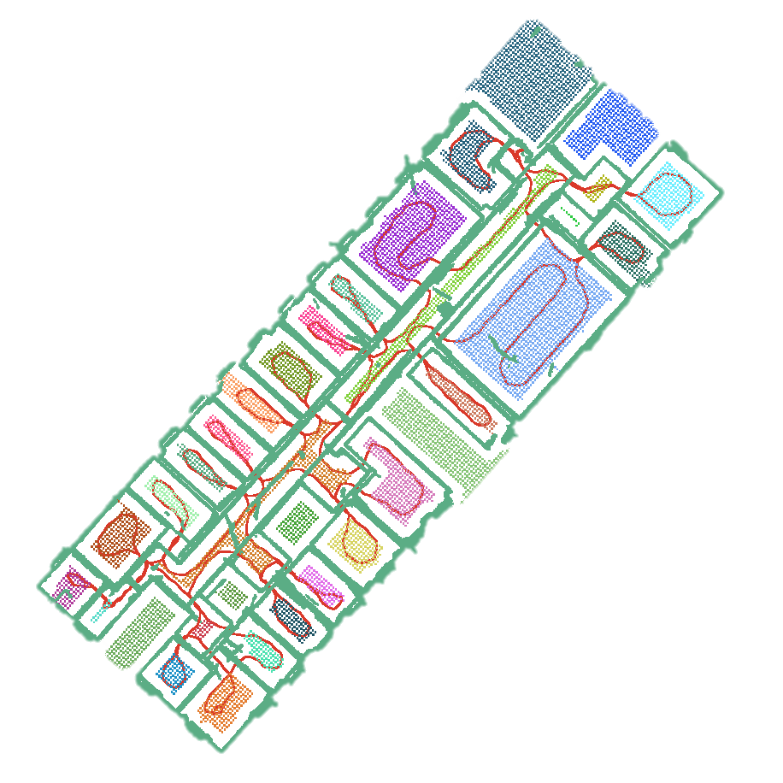
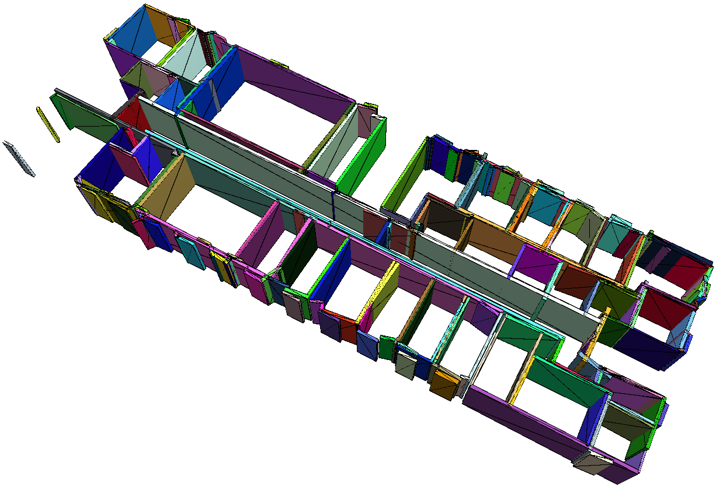
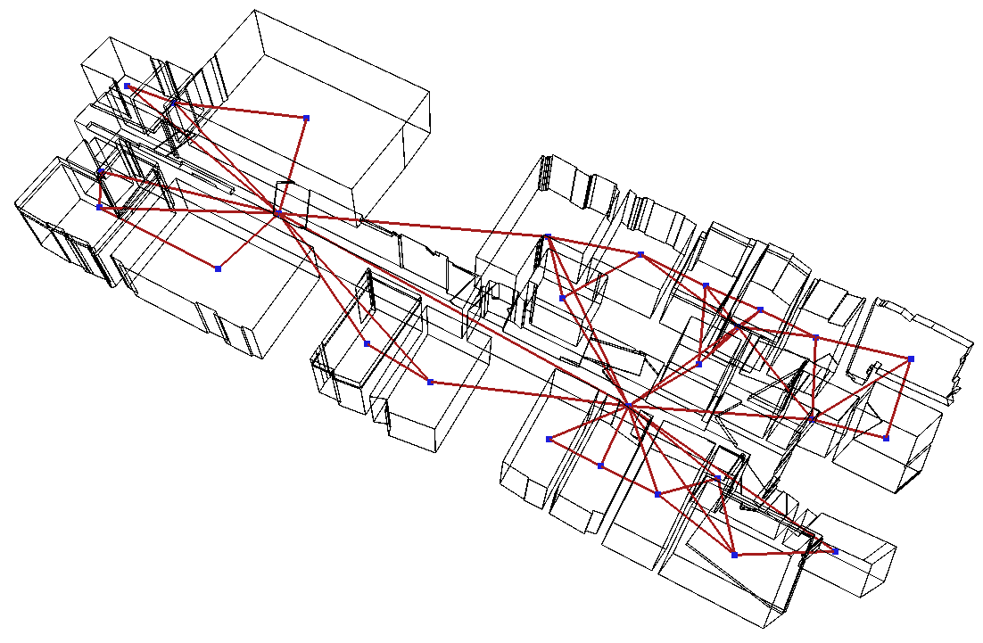
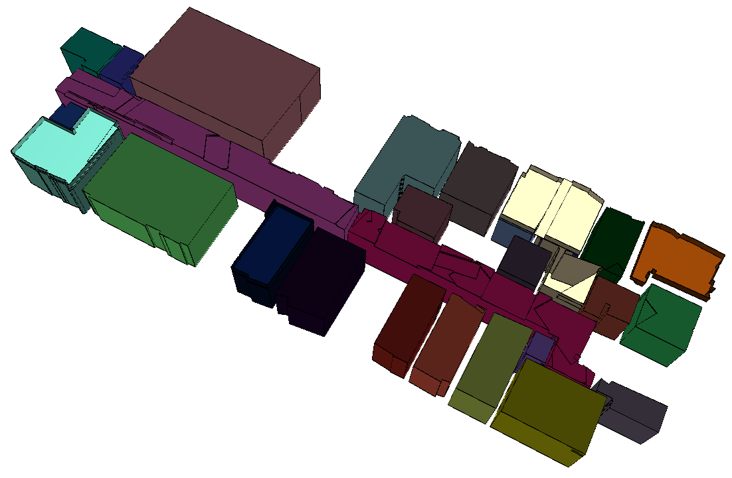
Indoor 3D Model Reconstruction to Support Disaster Management in Large Buildings
Smart Indoor Models in 3D (SIMs3D)
Walls from point clouds
Walls
(not modified)
Spaces graph
Spaces

Slide 16
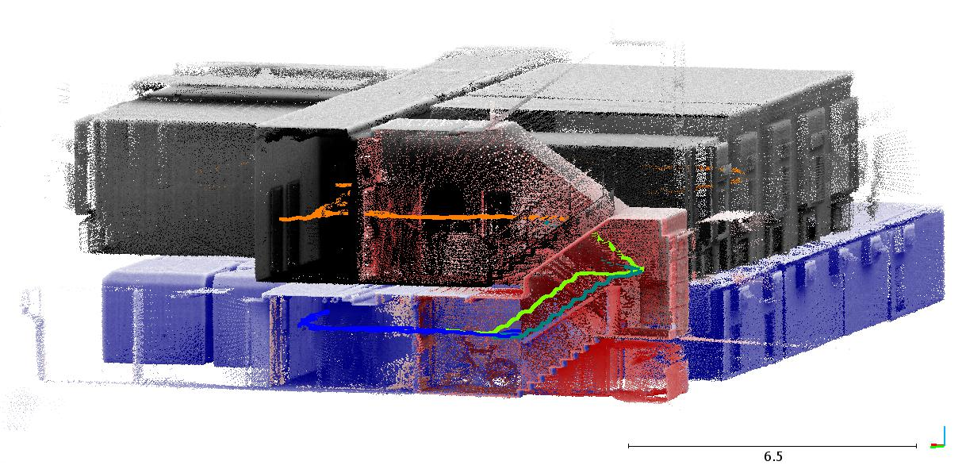
Indoor 3D Model Reconstruction to Support Disaster Management in Large Buildings
Smart Indoor Models in 3D (SIMs3D)
Msc Student’s work (Ahmed El Seicy)
Joint analysis of trajectories and point clouds
Zeb1 point cloud
source: A. El Seicy thesis

Slide 17
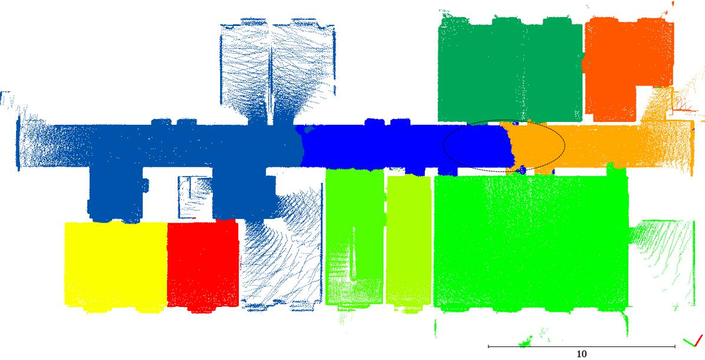
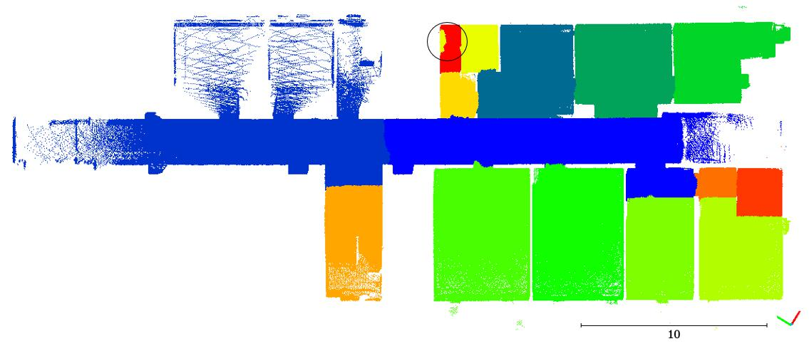
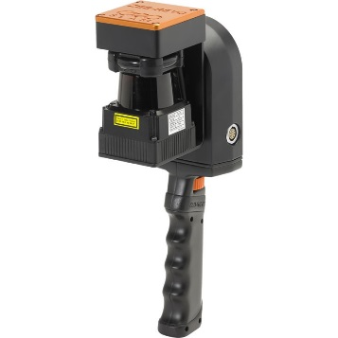
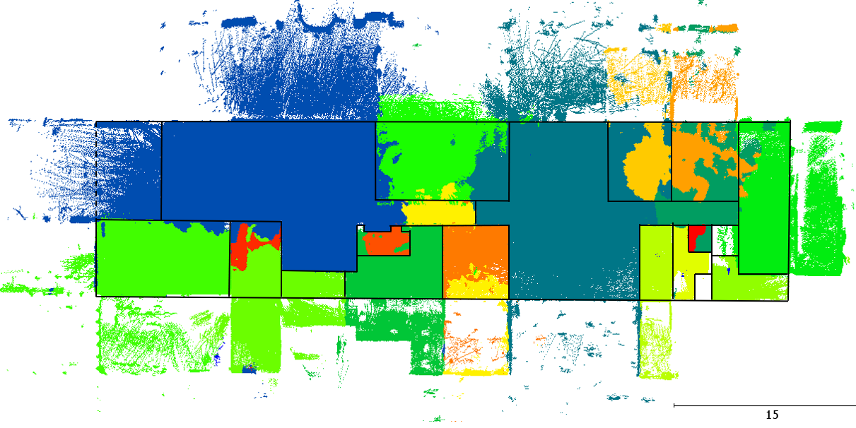
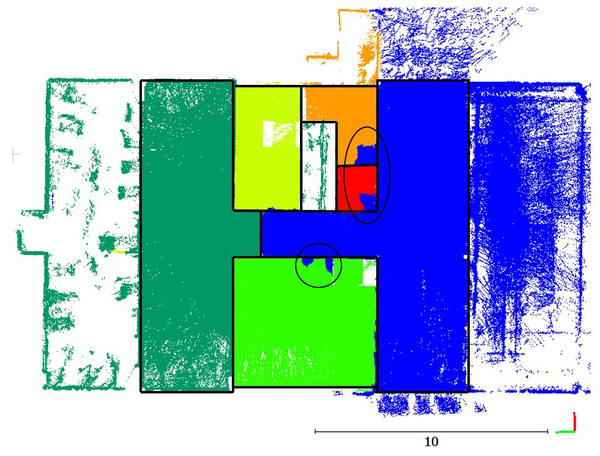
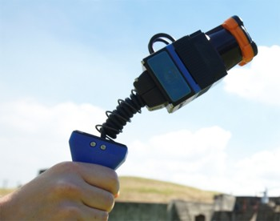
Room Segmentation
source: A. Elseicy’s Msc Thesis

Slide 18
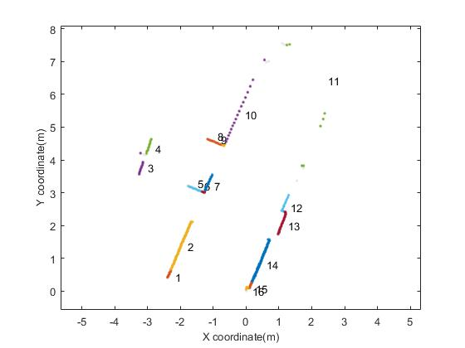
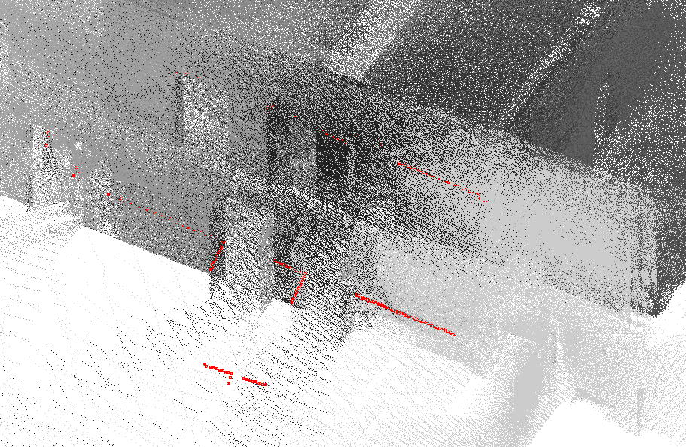
Indoor 3D Model Reconstruction to Support Disaster Management in Large Buildings
Smart Indoor Models in 3D (SIMs3D)
Msc Student’s work (Yi Zheng)
Analysis of scan lines for object extraction and space subdivision
3D Scanline in point clouds
Corresponding 2D scanline

Slide 19
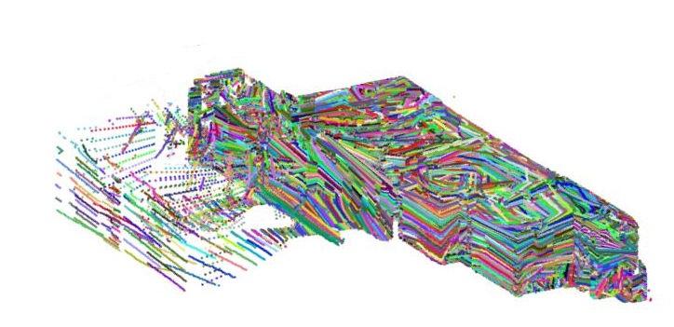
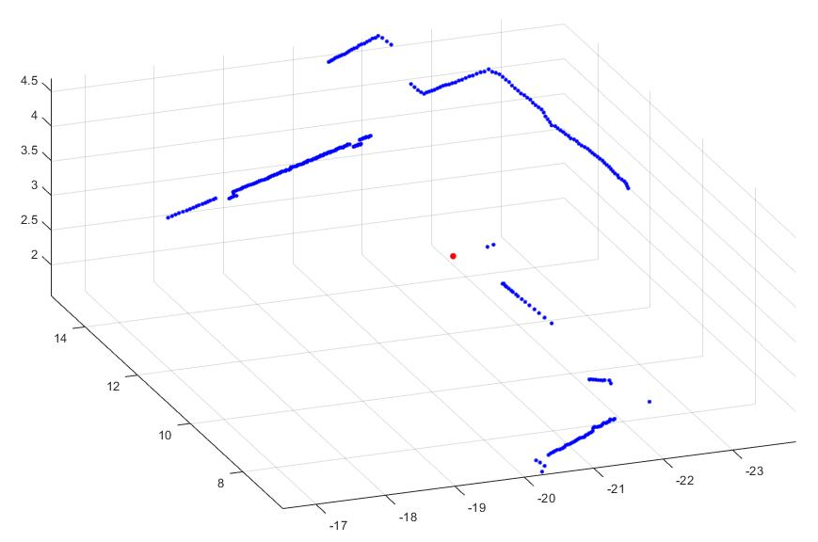
Indoor 3D Model Reconstruction to Support Disaster Management in Large Buildings
Smart Indoor Models in 3D (SIMs3D)
Raw 3D point cloud
3D scanlines
Example of single scanline in different roll angle

Slide 20
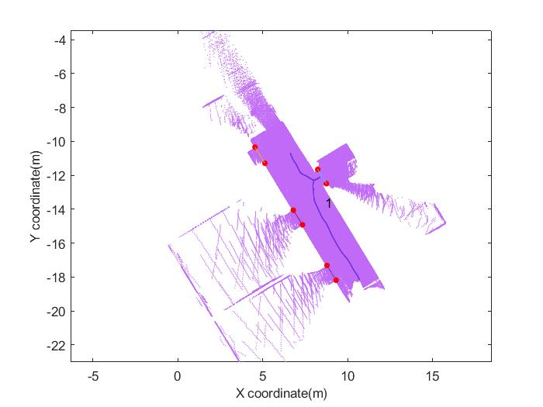
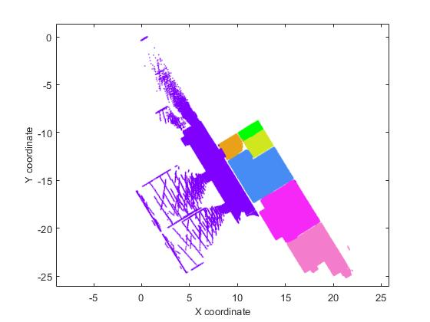
Indoor 3D Model Reconstruction to Support Disaster Management in Large Buildings
Smart Indoor Models in 3D (SIMs3D)
Msc Student’s work
Analysis of scan lines for Space subdivision
Corresponding point clouds
Example of point clouds subdivision
Result of subdivide point clouds

Slide 21
Indoor 3D Model Reconstruction to Support Disaster Management in Large Buildings
Smart Indoor Models in 3D (SIMs3D)
Conclusion:
The integration of results are promising in terms of accuracy
The methods need to be tested on a multistorey building
The manual corrections are trivial for an expert
The time of modeling is decreased to less than an hour (processing + interactive refinement)
The potential of generating BIM models should be further investigated
The accuracy of walls, volumes and doors is strongly dependent on the sensor accuracy and the noise.

